Slide 1

MBEYA UNIVERSITY OF SCIENCE AND TECHNOLOGY COLLEGE: CET DEPARTMENT: MIE ORDINARY DIPLOMA IN AUTO ELE & AUTO, SAFETY AND MECHANICAL ENGINEERING (SECOND YEAR) MODULE NAME: MACHINE ELEMENT AND DESIGN I CODE: ME 6112 TOPIC 1: INTRODUCTION TO MACHINE ELEMENT AND DESIGN ACADEMIC YEAR: 2025/2026 SEMESTER: II

Slide 2
FACILITATOR: Eng. KULWA KISHOSHA LUTEMA CONTACTS: Phone: 0765 316 760 Email: kishoshakl3@gmail.com LECTURE ROOM/TIME: Tuesday; SPORT HALL (19:15 – 21:30PM) Friday; LPII-BF-R (09:55-12:10) OFFICE: MECHANICAL STAFF ROOM C-204

Slide 3
LECTURE 1: INTRODUCTION TO MACHINE ELEMENT AND DESIGN IN MACHINE ELEMENT AND DESIGN I

Slide 4
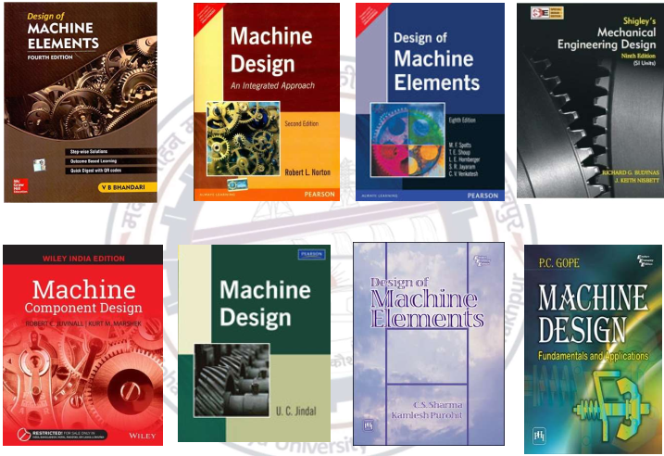

Slide 5
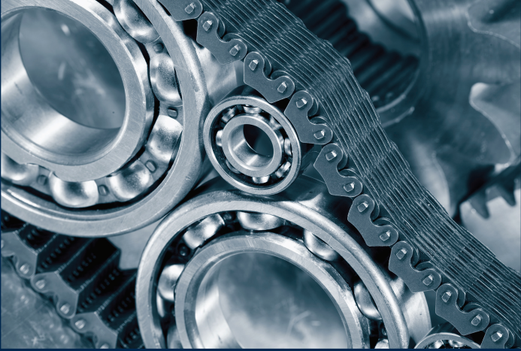
.

Slide 6
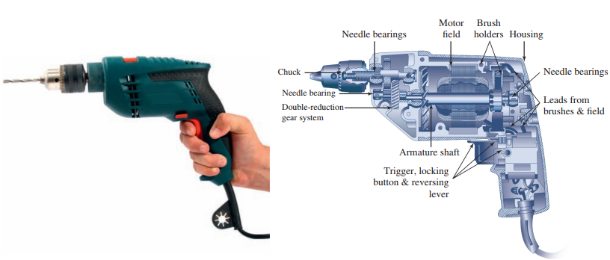
.

Slide 7
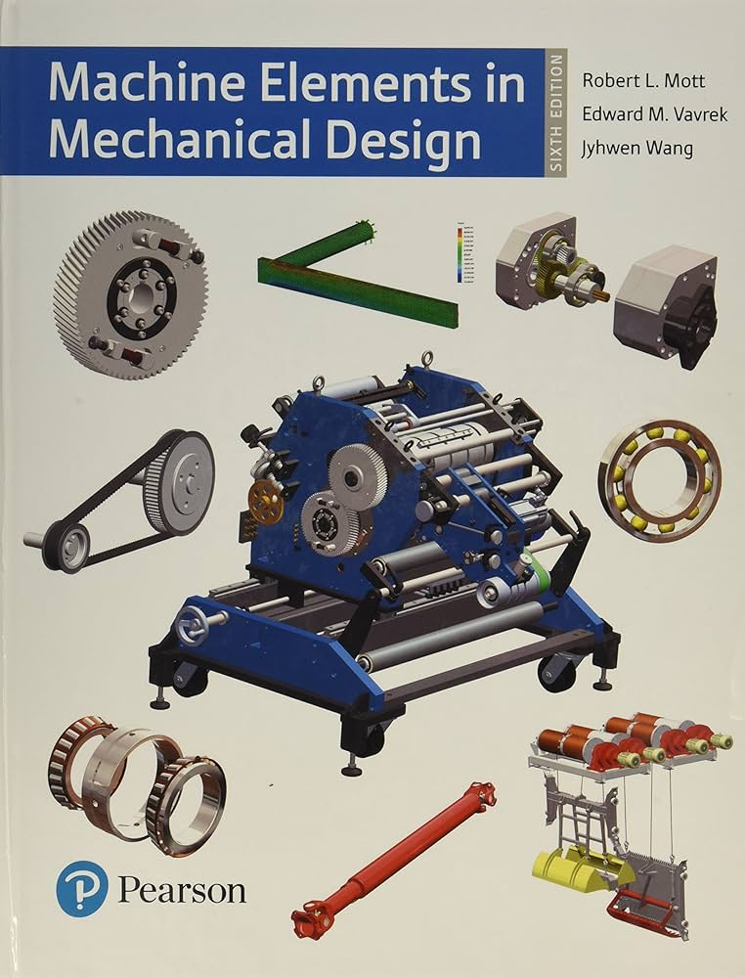
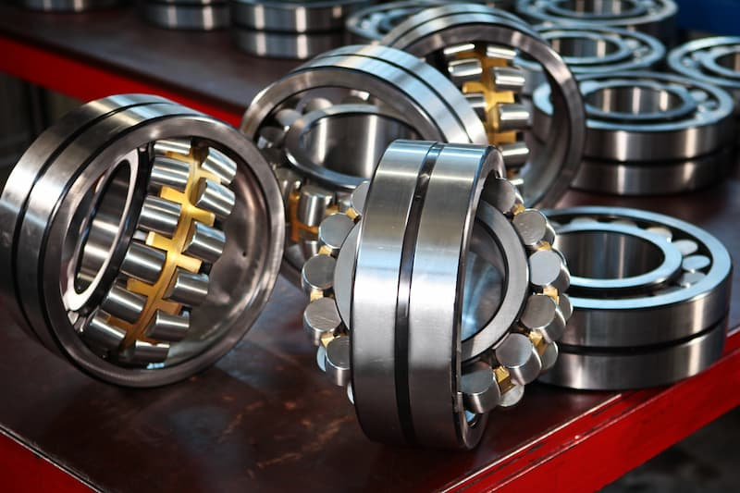
.

Slide 8
Introduction
Design is the transformation of concepts and ideas into useful machinery (conceive, invent, contrive).
Engineering, Thomas Tredgold, “is the art of directing the great sources of power in nature for the use and convenience of man”
Engineering design is the process of applying the various techniques and scientific principles for the purpose of defining a device, a process, or a system in sufficient detail to permit its realization.
Machine Design is the creation of new and better machines and improving the existing ones that works safely, reliably and well.

Slide 9
CONT…
Design of machine elements is an integral part of the larger and more general field of mechanical design.
Design engineers create devices or systems to satisfy specific needs.
Mechanical devices typically involve moving parts that transmit power and accomplish specific patterns of motion.
Mechanical systems are composed of several mechanical devices.
Therefore, to design mechanical devices and systems, you must be competent in the design of individual machine elements that comprise the system.
But you must also be able to integrate several components and devices into a coordinated, robust system that meets your customer’s needs.

Slide 10
CONT…
Machine: is an apparatus consisting of interrelated unit (elements) that modifies force or motion.
Machine is a combination of mechanisms and other components that transforms, transmits, or uses energy, load, or motion for a specific purpose.
Machine comprises several different machine elements properly designed and arranged to work together as a whole.
The objective is to produce a machine that not only is sufficiently rugged to function properly for a reasonable time, but also is economically feasible.

Slide 11
CONT…
Machine element may function as a
Normal load transmitter: rolling-element bearings, hydrodynamic bearings, and rubbing bearings.
Torque transmitter: gears, shafts, chains, and belts.
Energy absorber: Brakes and dampers
Seal
Economics and functionality are always pressing concerns, and good design inherently means safe, economical, and functional design.

Slide 12
CONT…
Machines create motion and develop forces.
It is the engineer’s task to define and calculate those motions, forces, and changes in energy in order to determine the sizes, shapes, and materials needed for each of the interrelated parts in the machine.
THIS IS THE ESSENCE OF MACHINE DESIGN
The ultimate objective of mechanical design is to produce a useful product that satisfies the needs of a customer and that is safe, efficient, reliable, economical, and practical to manufacture.

Slide 13
What to expect during designing process?
Designing process is long (time consuming).
From the study of existing ideas,
A new idea has to be conceived.
The idea is then studied (analysed) keeping in mind its commercial success and given shape in the form of drawings.
Preparation of drawings
Availability of resources: money, men and materials to turn new idea into an actual reality

Slide 14
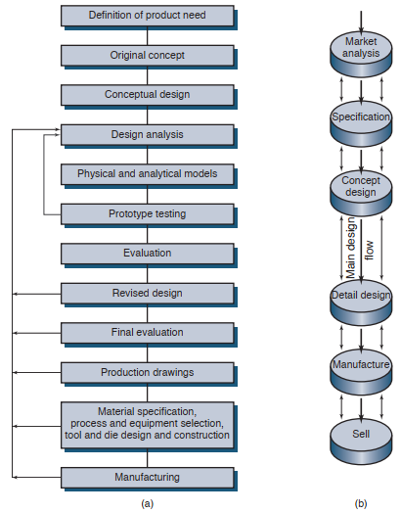
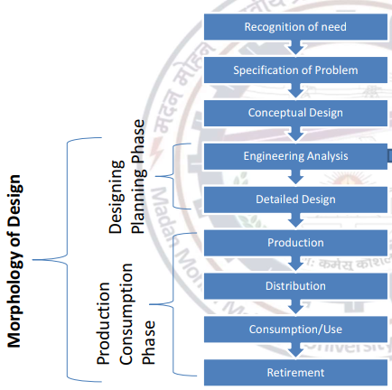
.

Slide 15
Important Knowledge in Machine Design
SKILLS
Creativity, problem solving, and project management
Oral communication, listening, technical writing and teamwork skills
Engineering Drawing (Sketching, technical drawing, 2D and 3D CAD) and CAE
Workshop Processes (Manufacturing processes)
KNOWLEDGE
Mathematics,
Engineering Mechanics (Statics, dynamics, kinematics, and mechanisms)
Engineering Material (Properties and materials processing)
Strength of Materials (Stress analysis )
Theory of Machines (Machine elements)

Slide 16
Type of design
Adaptive design.
The designer’s work is concerned with adaptation of existing designs.
Needs no special knowledge or skill and can be attempted by designers of ordinary technical training.
The designer only makes minor modification in the existing designs.

Slide 17
CONT…
Development design.
Needs considerable scientific training and design ability in order to modify the existing designs into a new idea by adopting a new material or different method of manufacture.
In this case: though the designer starts from the existing design, but the final product may differ quite markedly from the original product.

Slide 18
CONT…
New design.
Needs lot of research, technical ability and creative thinking.
Only those designers who have personal qualities of a sufficiently high order can take up the work of a new design.

Slide 19
Factors to be considered in Machine Design
What mechanism to be used? Relative arrangement of the constituent elements.
Material Forces on the elements
Size, shape and space requirements. The final weight is also a major concern.
The method of manufacturing the components and their assembly.
How will it operate?
Reliability and safety aspects
Inspectability
Maintenance, cost and aesthetics of the designed product

Slide 20
General Considerations in Machine Design
Type of load and stresses caused by the load:
Stress induced can be Compressive, Tensile, Shear, Bending or Torsional stress.
Motion of the parts or kinematics of the machine:
The arrangement of the parts determine the motion required.
The motion of the parts may be: Rectilinear motion (unidirectional and reciprocating motions), Curvilinear motion (rotary and simple harmonic) or Constant velocity.

Slide 21
CONT…
Selection of materials:
Knowledge of the properties of materials and their behaviour under working conditions.
Properties of materials: strength, durability, flexibility, weight, resistance to heat and corrosion, ability to cast, welded or hardened, machinability, electrical conductivity, etc.
Factors to be considered: availability, suitability for the working conditions and the cost of the material.

Slide 22
CONT…
Form and size of the parts:
It is necessary to know the forces which the part must sustain and anticipate any sudden impact load which may cause failure.
Frictional resistance and lubrication:
Loss of power due to frictional resistance should be noted
Convenient and economical features:
The starting, controlling and stopping levers should be located on the basis of convenient handling, and the adjustment for wear must be provided

Slide 23
CONT…
Use of standard parts:
The use of standard parts is closely related to cost,
Should be used whenever possible; Parts such as gears, bolt and nuts, motors, belts, bearings and other parts are selected.
Safety of operation:
Any moving part of a machine which is within the zone of a worker is considered an accident hazard and may be the cause of an injury.
Thus, during design process, safety has to be considered to avoid unnecessary accident.

Slide 24
CONT…
Workshop facilities.
A design engineer should be familiar with the limitations of his employer’s workshop, in order to avoid the unnecessary cost.
Number of machines to be manufactured.
The engineering and shop costs which are called fixed charges or overhead expenses are distributed over the number of articles to be manufactured.
If only a few articles are to be made, extra expenses are not justified unless the machine is large or of some special design.

Slide 25
CONT…
Cost of construction:
The aim of design engineer under all conditions, should be to reduce the manufacturing cost to the minimum.
Assembling.
Every machine must be assembled as a unit before it can function.
Other factors to be considered: reliability, friction, usability, utility, cost, life, noise, thermal properties, surface, lubrication, marketability, maintenance, volume, liability, recovery.

Slide 26
CONT…
product must be
Functional
Safe
Reliable
Competitive
Usable
Manufacturable
Comply with codes and standards
Design is
An innovative: creating new / improving existing product.
Highly iterative: involve creating and refining multiple version of product until the desired outcome is achieved.
Decision making process: series of choices i.e., selection of materials, loading and kinematics.

Slide 27
Significance of Mechanical Design
Solving a problem: Provide solution to specific problems, such as addressing user needs, reducing cost or improving the performance of the product.
Design best shapes for a product: creating visual appealing design
Provides detailed drawings to aid the manufacturing process
Cost savings
Safety

Slide 28
Comparison
 | DESIGNED WORK | UN DESIGNED WORK
Standard | Followed | Not Followed
Accuracy and precision | Followed | Are not followed
Ergonomic and economic factors | Considered | Are not considered
Details drawing and size of machine | Considered | Not considered
Tolerance and limits | Considered | Are not considered
Machine cost and output | Considered | Are not considered

Slide 29
Design procedure (General Procedure)
Recognition of need: First of all, make a complete statement of the problem, indicating the need, aim or purpose for which the machine is to be designed.
Synthesis (Mechanisms): Select the possible mechanism or group of mechanisms which will give the desired motion.
Analysis of forces: Find the forces acting on each member of the machine and the energy transmitted by each member.

Slide 30
CONT…
Material selection: Select the material best suited for the machine.
Design of elements (Size and Stresses): Find the size of each member of the machine by considering the force acting on the member and the permissible stresses for the material used.
Modification: Modify the size of the member to agree with the past experience and judgment to facilitate manufacture and reduce overall cost.

Slide 31
CONT…
Detailed drawing: Draw the detailed drawing of each component and the assembly of the machine with complete specification for the manufacturing processes suggested.
Production. The component, as per the drawing, is manufactured in the workshop.

Slide 32
Characteristics of a good designer
Engineering and design skills: CAD software such CATIA, Solidworks, Autodesk inventor, CFD and analysis software.
Creative and Analytical thinking: Push beyond of what currently exists.
Excellence in communication and team work: Between engineers and non-engineers orally and in writing.
Problem solving (innovative)
Attention to details: Accuracy and precision.

Slide 33
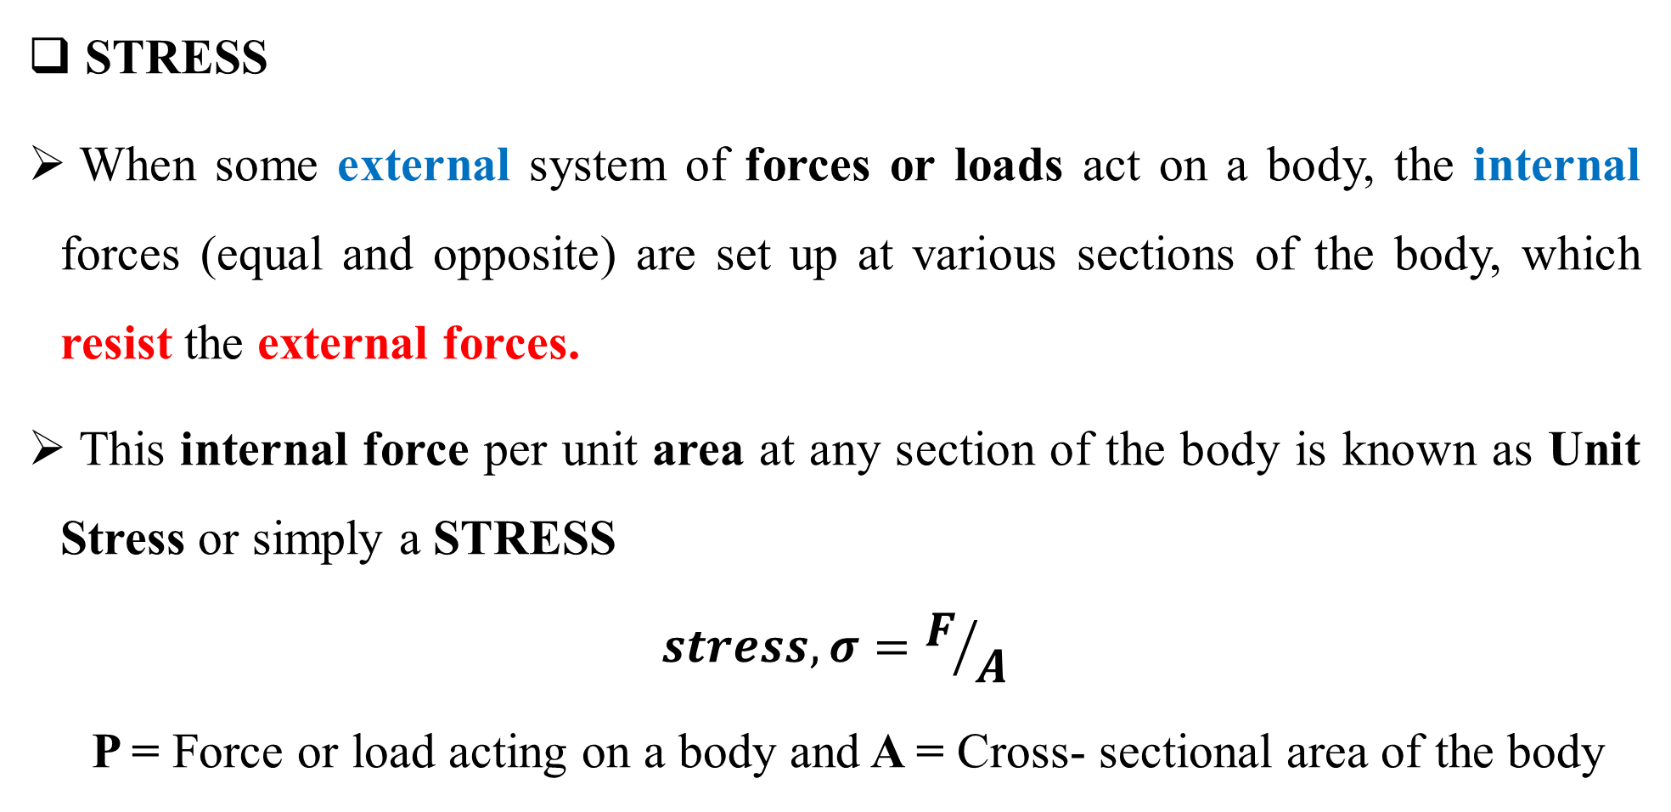
Design Terminology
STRESS
When some external system of forces or loads act on a body, the internal forces (equal and opposite) are set up at various sections of the body, which resist the external forces.
This internal force per unit area at any section of the body is known as Unit Stress or simply a STRESS
$$stress, σ=F/A$$
P = Force or load acting on a body and A = Cross- sectional area of the body

Slide 34
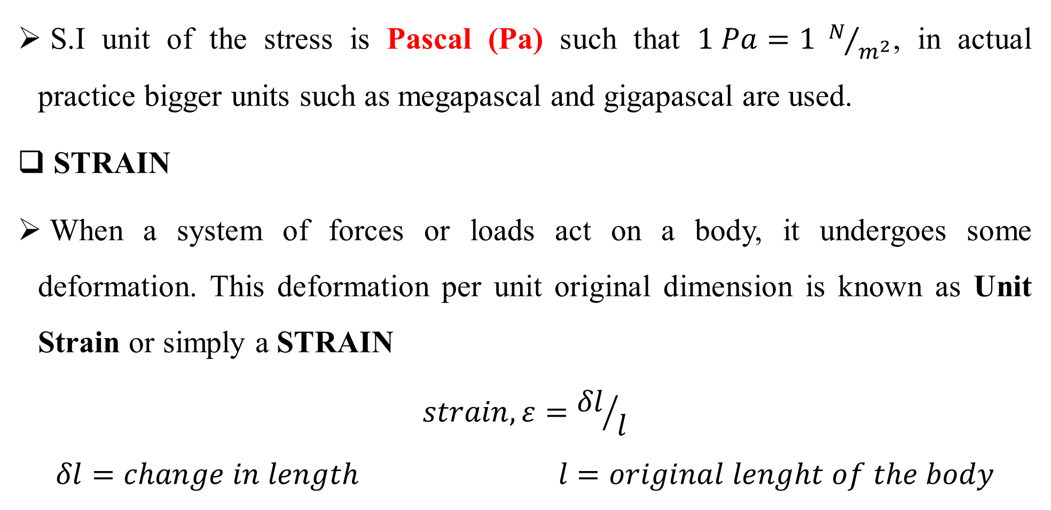
CONT…
S.I unit of the stress is Pascal (Pa) such that $1 Pa=1 N/{m^{2}}$, in actual practice bigger units such as megapascal and gigapascal are used.
STRAIN
When a system of forces or loads act on a body, it undergoes some deformation. This deformation per unit original dimension is known as Unit Strain or simply a STRAIN
$$strain, ε={δl}/l$$
$$δl=change in length l=original lenght of the body$$

Slide 35
Stress And Strain
Tensile stress and strain
Compressive stress and strain
Young’s modulus or Modulus of elasticity
Hooke's law* states that when a material is loaded within elastic limit, the stress is directly proportional to strain.
Shear stress and strain
Shear modulus or Modulus of rigidity

Slide 36
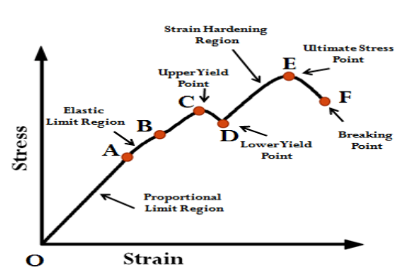
CONT…
Stress-Strain diagram
Proportional limit, Elastic limit, Yield point, Ultimate stress, Breaking stress, Percentage reduction in area and percentage elongation.

Slide 37
Factor of safety
Working Stress:
When designing machine parts, it is desirable to keep the stress lower than the maximum/ ultimate stress at which failure of the material takes place.
This stress is known as the working/ design stress.
It is also known as safe or allowable stress.
By failure it is not meant actual breaking of the material,
Some machine parts are said to fail when they have plastic deformation set in them.

Slide 38
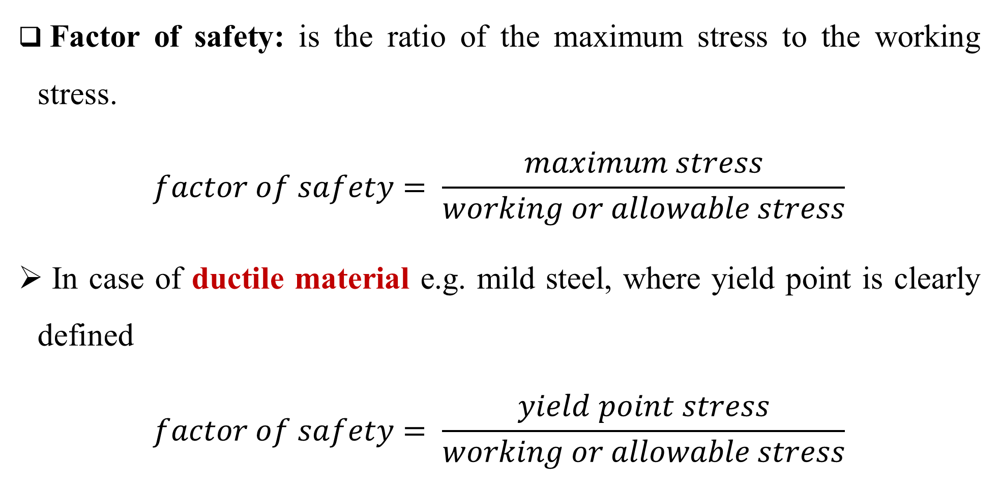
CONT…
Factor of safety: is the ratio of the maximum stress to the working stress.
$$factor of safety= \frac{maximum stress}{working or allowable stress}$$
In case of ductile material e.g. mild steel, where yield point is clearly defined
$$factor of safety= \frac{yield point stress}{working or allowable stress}$$

Slide 39
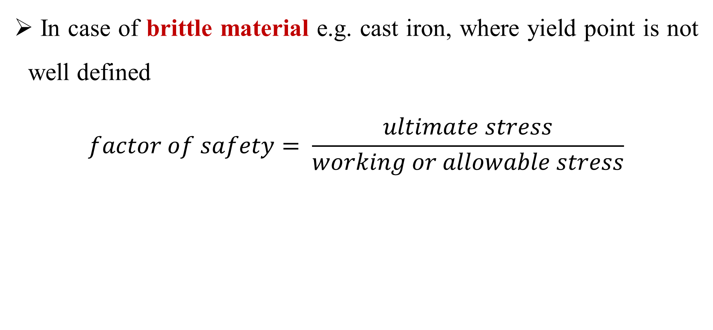
CONT…
In case of brittle material e.g. cast iron, where yield point is not well defined
$$factor of safety= \frac{ultimate stress}{working or allowable stress}$$

Slide 40
Factor Affecting Factor of Safety
Proper factor of safety selection depends on
The material,
Mode of manufacture,
Type of stress,
General service conditions,
Shape of the parts.

Slide 41
CONT…
Before selecting a proper factor of safety, a design engineer should consider the following factors
Material properties: The reliability of the properties of the material and applied load
Level of uncertainty: The certainty as to exact mode of failure
The extent of localized stresses and initial stresses set up during manufacture
Consequence of failure: The extent of loss of life and property if failure occurs.

Slide 42
Stress
There are two ways in which stress are acting on machine parts
Stresses due to static loading
Stress due to fluctuating or alternating loads (variable stress)
Only few machine parts are subjected to static loading, and the stress is constant.
Examples of static loading: seating on a chair, load on structure.

Slide 43
CONT…
Most of the machine parts (such as axles, shafts, crankshafts, connecting rods, springs, pinion teeth etc.) are subjected to variable or alternating loads.
When a machine parts is under fluctuating load it will lead to cyclic stress (maximum and minimum stress).
Design equations for an element against static load is different with that against fluctuating load.

Slide 44
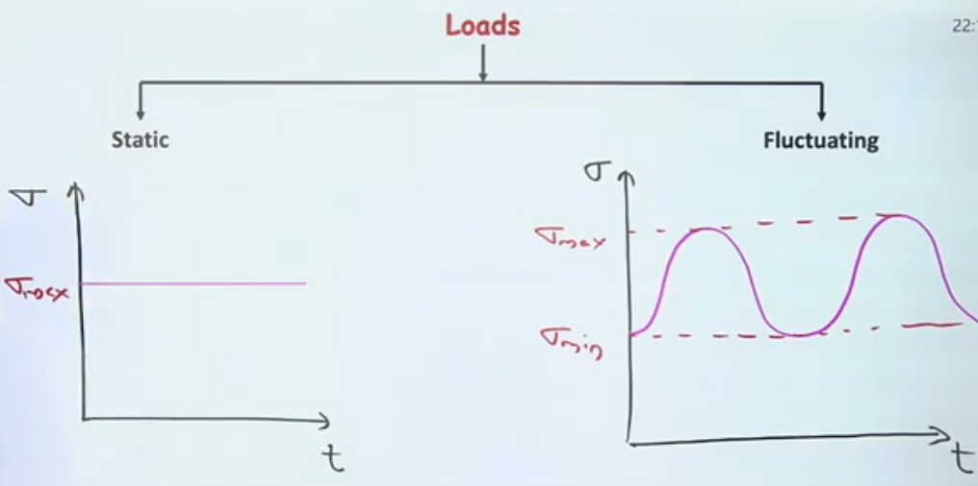
.

Slide 45
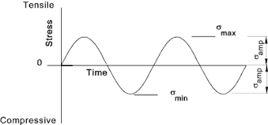
.

Slide 46
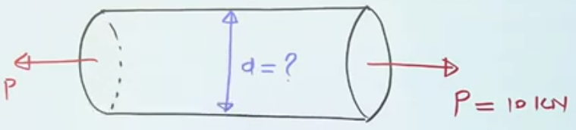
Design against static load
The load is constant over a certain amount of time
How is this member going to fail?

Slide 47
Failure under static load
Types of failure that occur when a machine is subjected to static load
Yielding: is the failure of a component due to an applied stress that is greater than the material's yield stress.
Hence 'yielding', and which does not necessarily cause fracture.
Fracture: is a form of failure where the material separates in pieces due to stress.

Slide 48

Cyclic Stresses
Consider a rotating beam of circular cross-section and carrying a load W
Cyclic Stress is a type of stress that occurs when material is subjected to repeated loading and unloading cycles.

Slide 49
CONT…
This load induces stresses in the beam which are cyclic in nature.
Upper fibres of the beam (i.e. at point A) are under compressive stress and the lower fibres (i.e. at point B) are under tensile stress.
After half a revolution, the point B occupies the position of point A and the point A occupies the position of point B.
Thus, the point B is now under compressive stress and the point A under tensile stress.

Slide 50
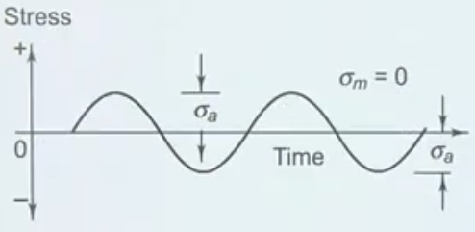
CONT…
Stresses which vary from one value of compressive to the same value of tensile or vice versa, are known as completely reversed or cyclic stresses.
This kind of cyclic stress is developed in many rotating machine parts that are carrying a constant bending load, Example: stress experienced by the gear of a car transmission.

Slide 51
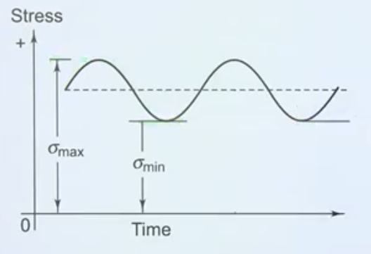
Notes
The stresses which vary from a minimum value to a maximum value of the same nature, (i.e. tensile or compressive) are called fluctuating stresses. Example: stress experienced by the blade of wind turbine.

Slide 52
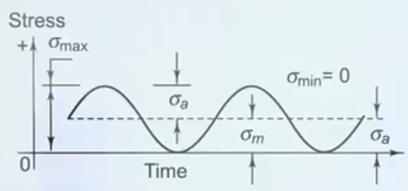
CONT…
The stresses which vary from zero to a certain maximum value are called repeated stresses. Example: stress experienced by car suspension system on rough road.

Slide 53
CONT…
The stresses which vary from a minimum value to a maximum value of the opposite nature are called alternating stresses. Example: piston and connecting rod in reciprocating engine

Slide 54

Stress concentration
Stress concentration is the localization of high stresses due to the irregularities present in the component and abrupt changes of the cross section..
Stress is significantly higher in a localized region of a material than in the surroundings area.

Slide 55
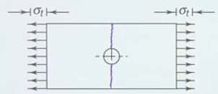
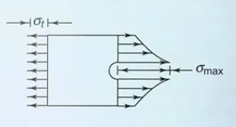
.

Slide 56
Causes of stress concentration
sudden change in area
Variation in material properties
Load applied at a very small area
Discontinuities due to holes, grooves, threads, fillets

Slide 57
CONT…
Such discontinuities are called stress raisers, and the regions in which they occur are called areas of stress concentration.
Stress concentrations can also arise from some irregularity not inherent in the member, such as tool marks, holes, notches, grooves, or threads.

Slide 58
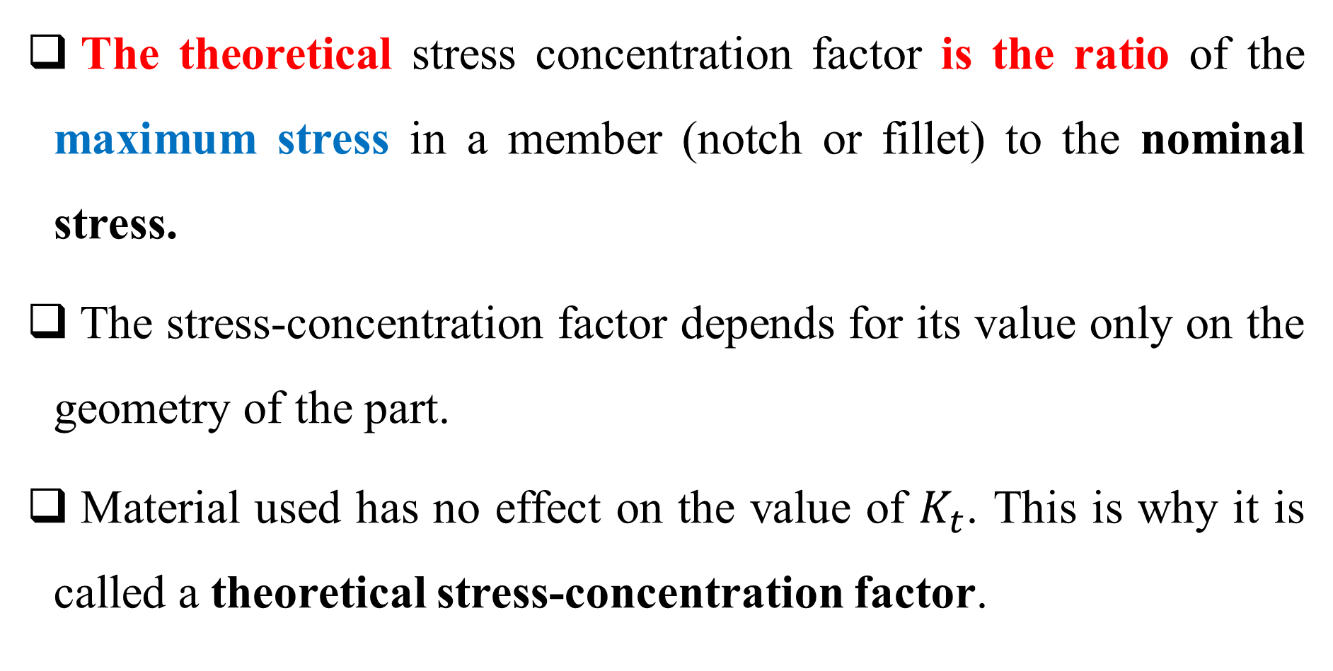
Stress Concentration Factor
The theoretical stress concentration factor is the ratio of the maximum stress in a member (notch or fillet) to the nominal stress.
The stress-concentration factor depends for its value only on the geometry of the part.
Material used has no effect on the value of $K_{t}$. This is why it is called a theoretical stress-concentration factor.

Slide 59
CONT…
The analysis of geometric shapes to determine stress-concentration factors is a difficult problem, and not many solutions can be found.
Most stress-concentration factors are found by using experimental techniques.

Slide 60
In static loading
Stress concentration in ductile materials is not so serious as in brittle materials,
In ductile materials local deformation or yielding takes place which reduces the concentration.
In brittle materials, cracks may appear at these local concentrations of stress which will increase the stress over the rest of the section.

Slide 61
In Cyclic Loading
Stress concentration in ductile materials is always serious
Because the ductility of the material is not effective in relieving the concentration of stress caused by cracks, flaws, surface roughness, or any sharp discontinuity in the geometrical form of the member.
If the stress at any point in a member is above the endurance limit of the material, a crack may develop under the action of repeated load and the crack will lead to failure of the member.

Slide 62
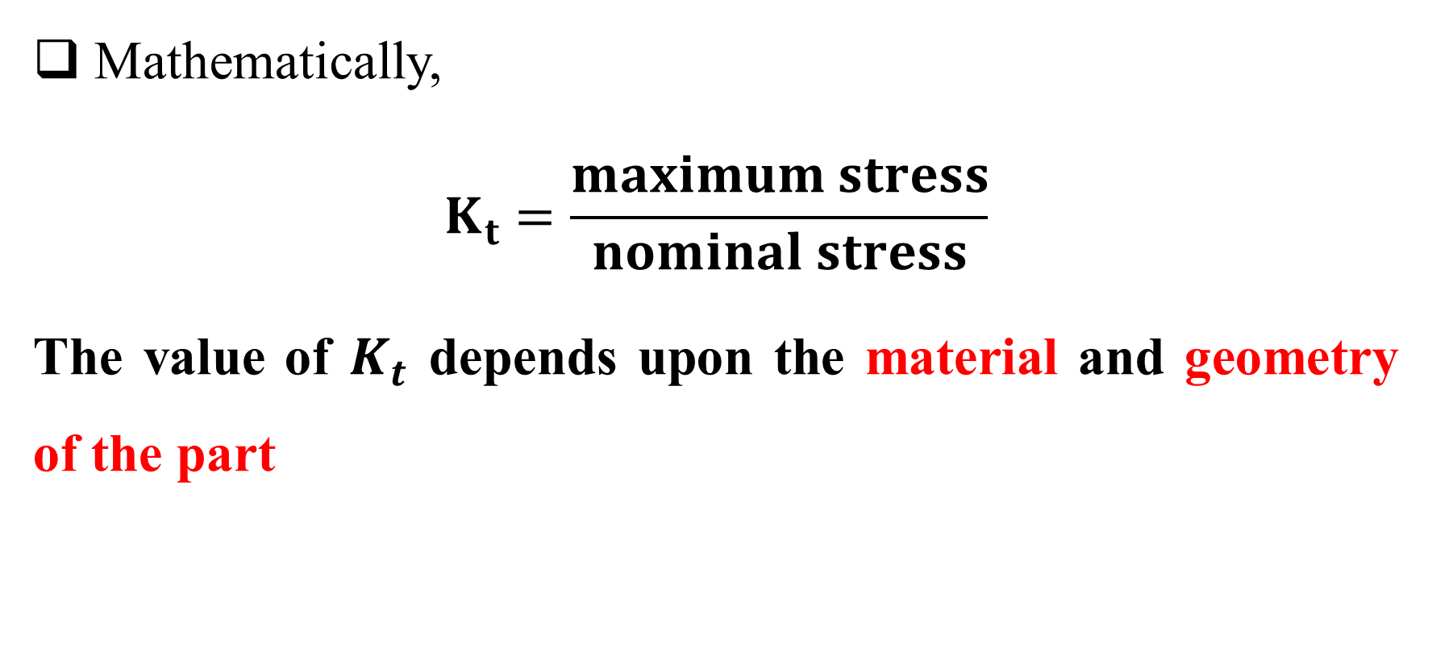
CONT…
Mathematically,
$$K_{t}=\frac{maximum stress}{nominal stress}$$
The value of $K_{t}$ depends upon the material and geometry of the part

Slide 63
Notch Sensitivity Factor
NSF is a property of material which measures the sensitivity of material to stress concentration.
This value range from 0 to 1.

Slide 64
Methods of Reducing Stress Concentration
The presence of stress concentration cannot be totally eliminated but it may be reduced to some extent.
Smooth transitions: use fillets between sections of different geometries. Sharp corners in cross section can cause stress concentration.
Material selection: use materials with a high toughness or ductility, which can absorb more energy before failure.
Use reinforced material: such fibers and polymers to enhance strength and toughness.

Slide 65
CONT…
Heat treatment: improving microstructure and mechanical properties of the material
Finite element analysis (FEA): used to simulate and predict stress concentration in complex components.
Use gradual taper: in order to distribute stress over a large area

Slide 66
Fatigue
It has been found experimentally that when a material is subjected to repeated stresses, it fails at stresses below the yield point stresses.
Such type of failure of a material is known as fatigue.
The failure is caused by means of a progressive crack formation which are usually fine and of microscopic size.
The failure may occur even without any prior indication.

Slide 67
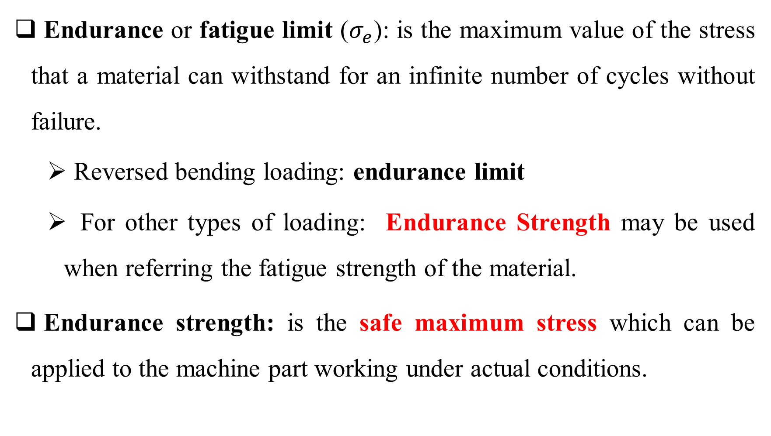
Endurance Limit
Endurance or fatigue limit ($σ_{e}$): is the maximum value of the stress that a material can withstand for an infinite number of cycles without failure.
Reversed bending loading: endurance limit
For other types of loading: Endurance Strength may be used when referring the fatigue strength of the material.
Endurance strength: is the safe maximum stress which can be applied to the machine part working under actual conditions.

Slide 68
Factor affecting the endurance limit
Types of loading (load factor) {reversed bending load, reversed axial load, reversed torsional load}
Surface finish (surface finish factor) {polished, machined, sharp notch, mill scale}
Size of the standard part (size factor)
Miscellaneous factors {reliability factor, temperature factor, impact factor, etc.}

Slide 69
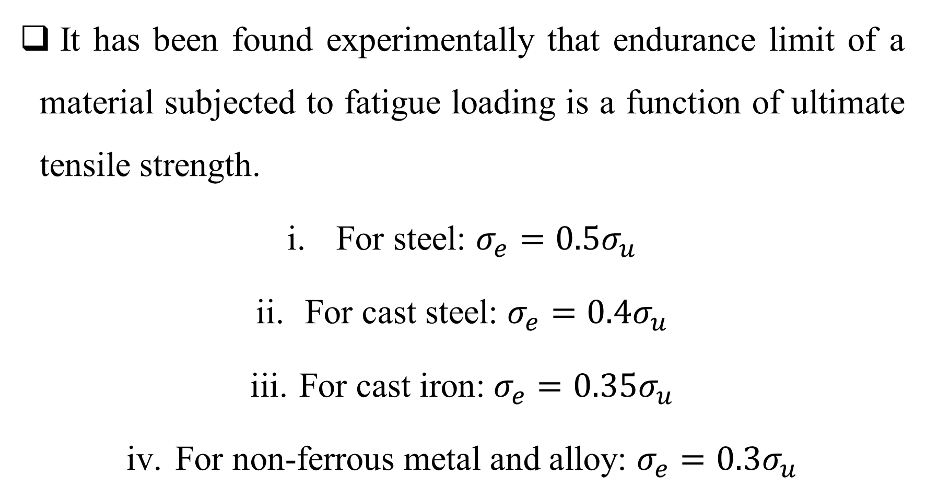
Note
It has been found experimentally that endurance limit of a material subjected to fatigue loading is a function of ultimate tensile strength.
For steel: $σ_{e}=0.5σ_{u}$
For cast steel: $σ_{e}=0.4σ_{u}$
For cast iron: $σ_{e}=0.35σ_{u}$
For non-ferrous metal and alloy: $σ_{e}=0.3σ_{u}$

Slide 70

Factor of Safety for Fatigue Loading
$$factor of safety, F.S= \frac{endurance limit stress}{working or allowable stress}$$

Slide 71
How to avoid Fatigue Failure
Factors to be Considered while Designing Machine Parts to Avoid Fatigue Failure
The variation in the size of the component should be as gradual as possible.
The holes, notches and other stress raisers should be avoided.
The stress de-concentrators such as fillets and notches should be provided.

Slide 72
CONT…
The parts should be protected from corrosive atmosphere.
Smooth finish of outer surface of the component increases the fatigue life.
The material with high fatigue strength should be selected

Slide 73
Codes and Standards (ISO standards)
Why are codes and standards important in machine design?
They establish safety requirement
They establish design criteria
They establish performance standards that a machine must meet.

Slide 74
CONT…
Standard is a set of specifications for parts, materials, or processes intended to achieve uniformity, efficiency, and a specified quality.
Standards are documents, formulated through a cooperative effort among industrial organizations, government agencies and other interested parties, that define good practice in a particular field (machine design).
One of the important purposes of a standard is to limit the multitude of variations that can arise from the arbitrary creation of a part, material, or process. .

Slide 75
Codes and standard in machine design
American Society of Mechanical Engineers (ASME)
ASME B31 (pressure pipping), ASME Y14 (engineering drawing and related documents)
International Standards Organization (ISO)
ISO 12100 (safety of machinery), ISO 13849 (safety related parts of control system)
Occupational safety and health Administration (OSHA)
Establish safety requirements for workers working near machine

Slide 76
CONT…
No matter how astute a designer may be, and how much experience she or he may have, familiarity with the codes and standards pertinent to a particular design project is essential.
Adherence to applicable codes and standards can provide experience-based guidance for the designer as to what constitutes good practice in that field, and assures that the product conforms to applicable legal requirements.

Slide 77
CONT…
Codes are usually legally binding documents, compiled by a governmental agency, that are aimed at protecting the general welfare of its constituents and preventing property damage, injury, or loss of life.
The purpose of a code is to achieve a specified degree of safety, efficiency, and performance or quality.

Slide 78
CONT…
The objectives of a code are accomplished by requiring the application of accumulated knowledge and experience to the task of avoiding, eliminating, or reducing definable hazards.
Codes are usually regarded as mandatory requirements that tell the user what to do and when to do it.
Codes often incorporate one or more standards, giving them the force of law.

Slide 79
CONT…
A designer’s responsibility includes seeking out all applicable codes and standards relating to her or his particular design project.
Designer and company, who does not follow code requirements, may be accused of professional malpractice and may be subject to litigation.

Slide 80
Thanks for your attention LEARNING IS THE PROCESS

